Slide 1

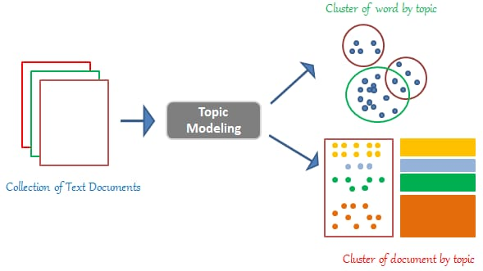
TEXT CLASSIFICATION
Mentor Name: Mr. Varun
Date: 26-06-2021
Prepared By:
Amit Kulkarni

Slide 2
Business Problem:
To classify text and identify category from the given statement
.
Objective:
To automate the text classification process (real time) based on user input to identify the category a content belongs

Slide 3
PROJECT FLOW
Preparing Dataset
Text Preprocessing
LDA Topic Building
LDA Visualization
Predictions
Clustering

Slide 4


Category Chosen
Politics
Sports

Slide 5
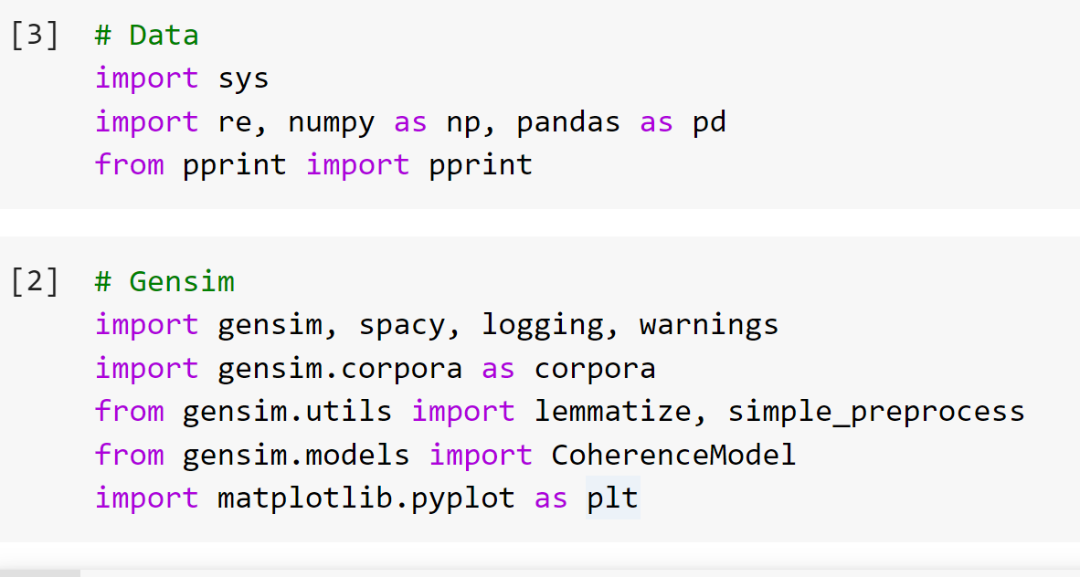
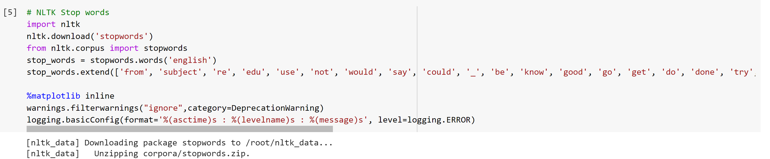
Importing the necessary libraries:
Pre-processing the text:

Slide 6
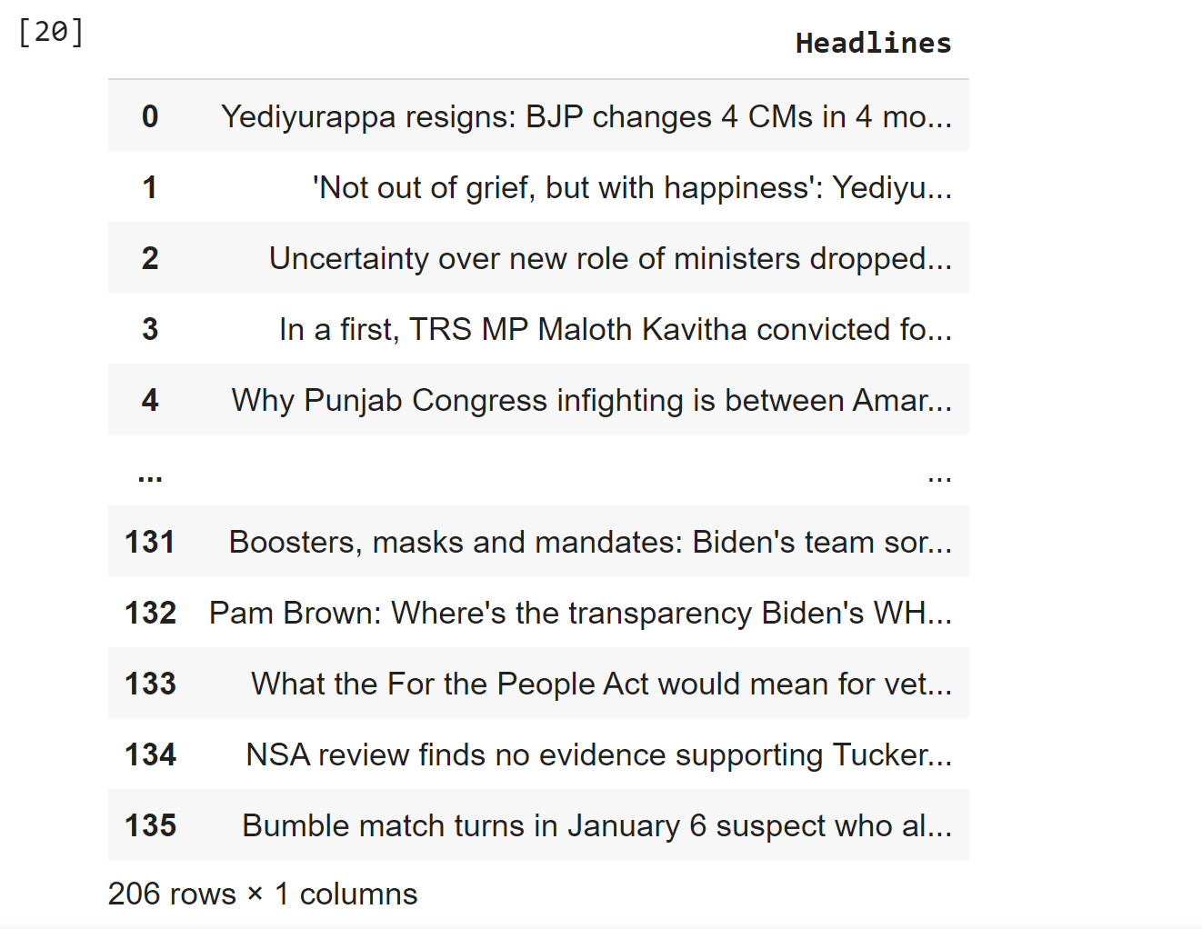
Analyzing the Topics:

Slide 7
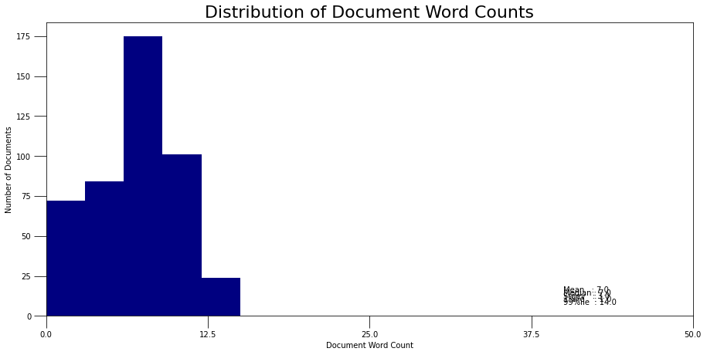
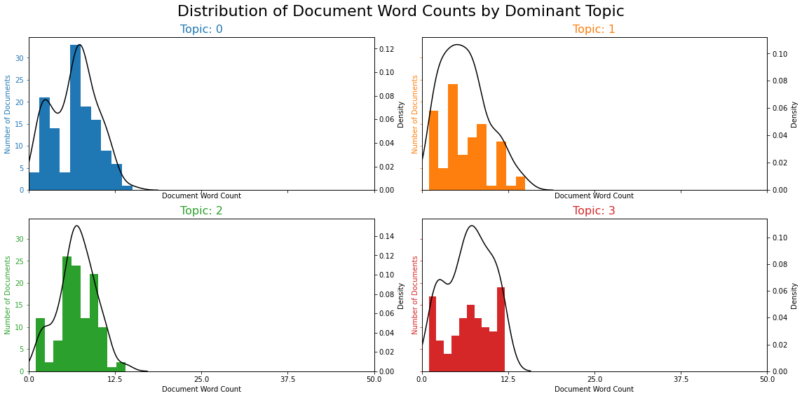
DATA VISULISATION

Slide 8
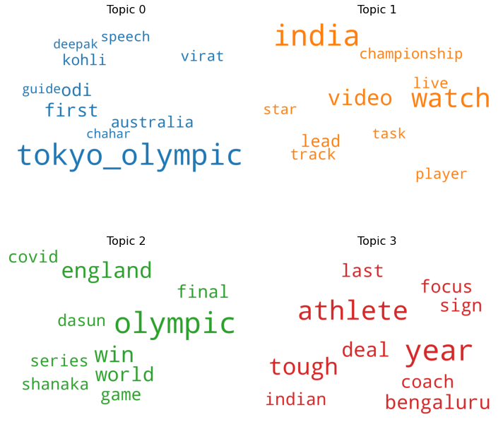
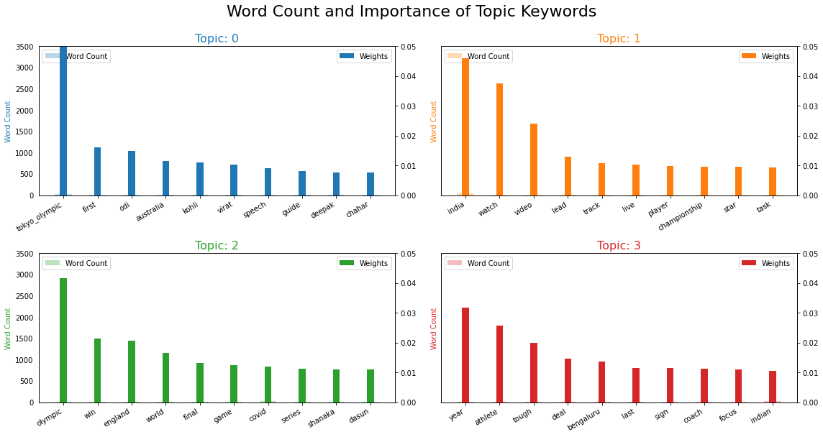
Word cloud of Top N words in each topic

Slide 9
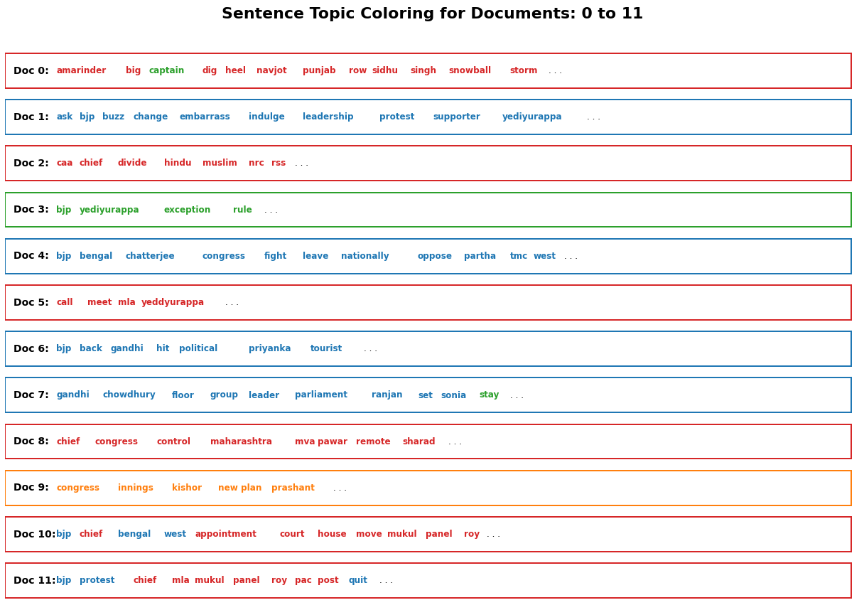
Sentence Coloring of N Sentences

Slide 10
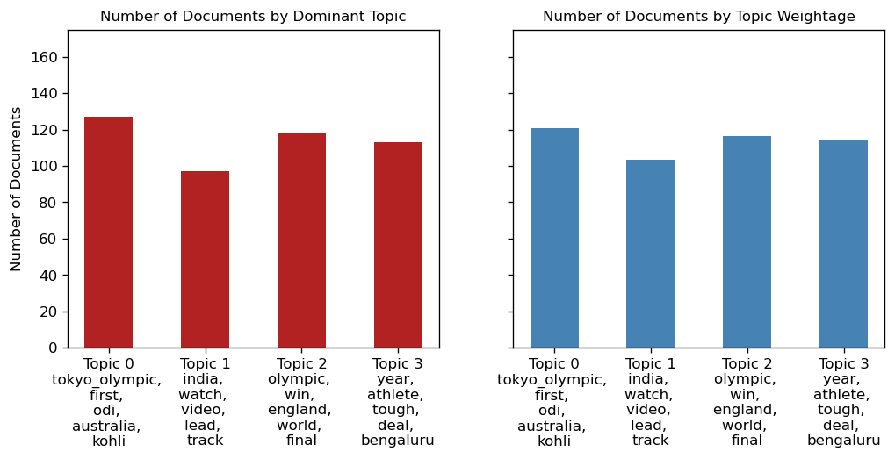
Topic Distribution by Dominant Topics & Topic Weightage

Slide 11
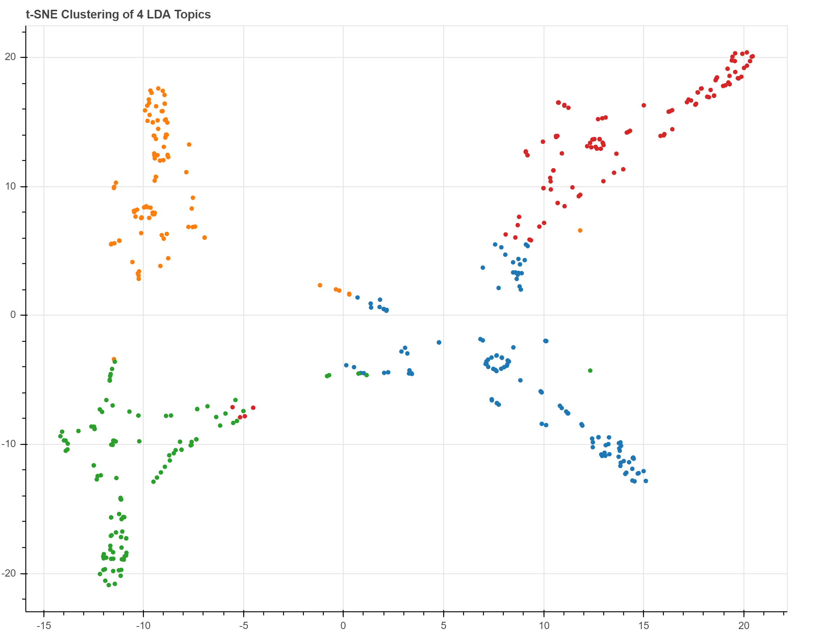
Plotting the Topic Clusters (t-SNE) using Bokeh

Slide 12
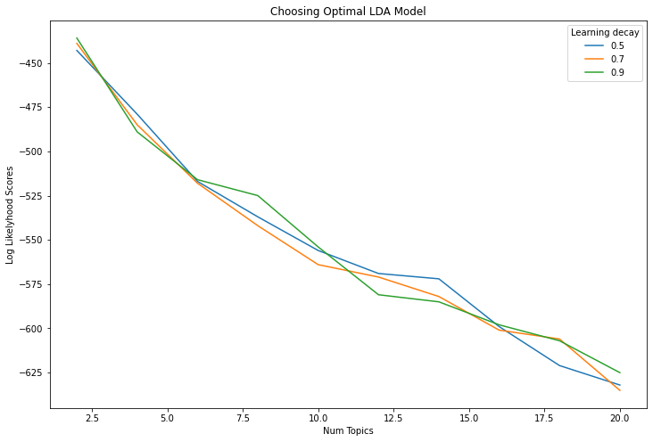
Log Likelyhoods from Grid Search Output

Slide 13
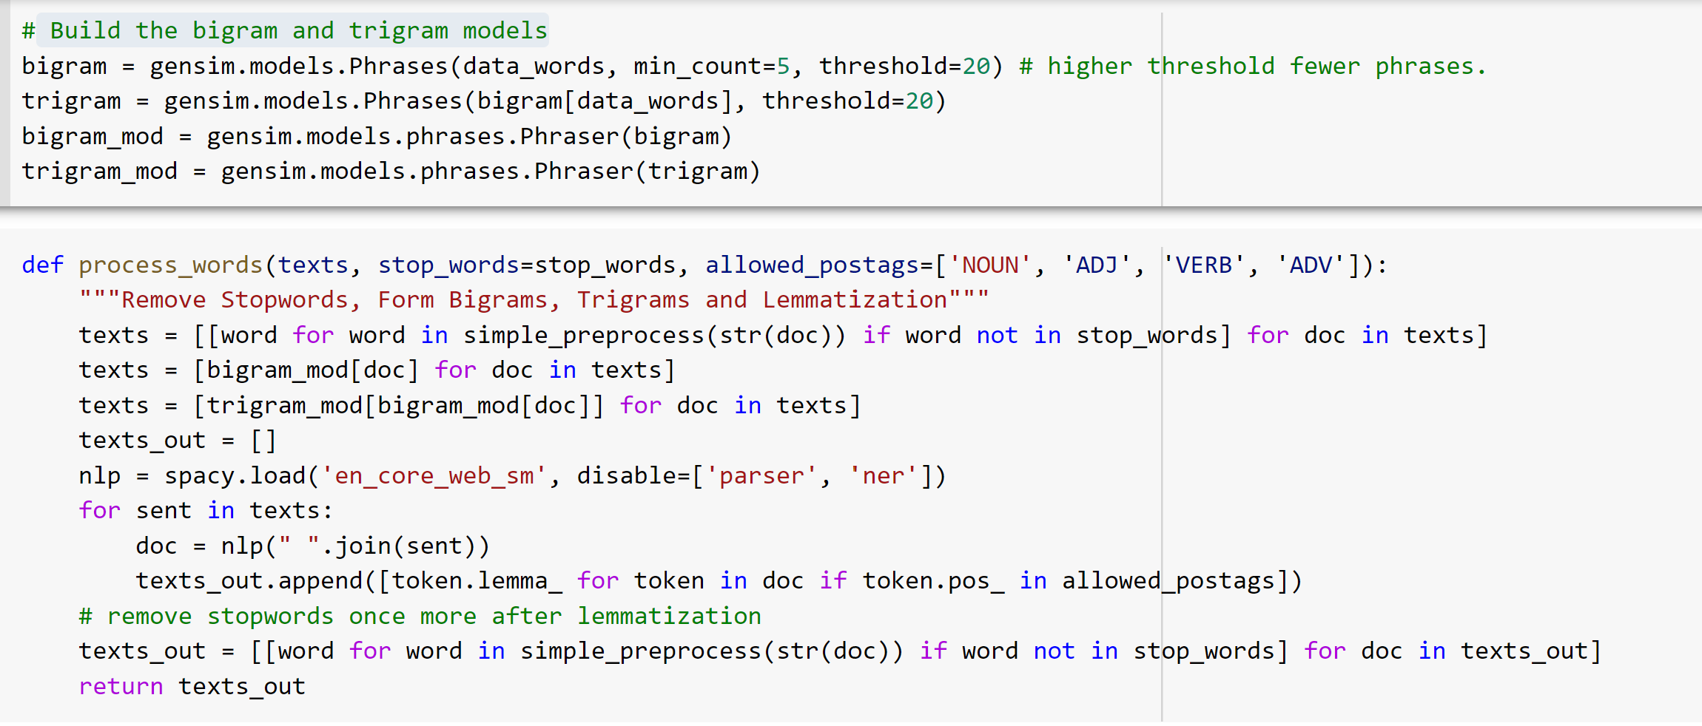
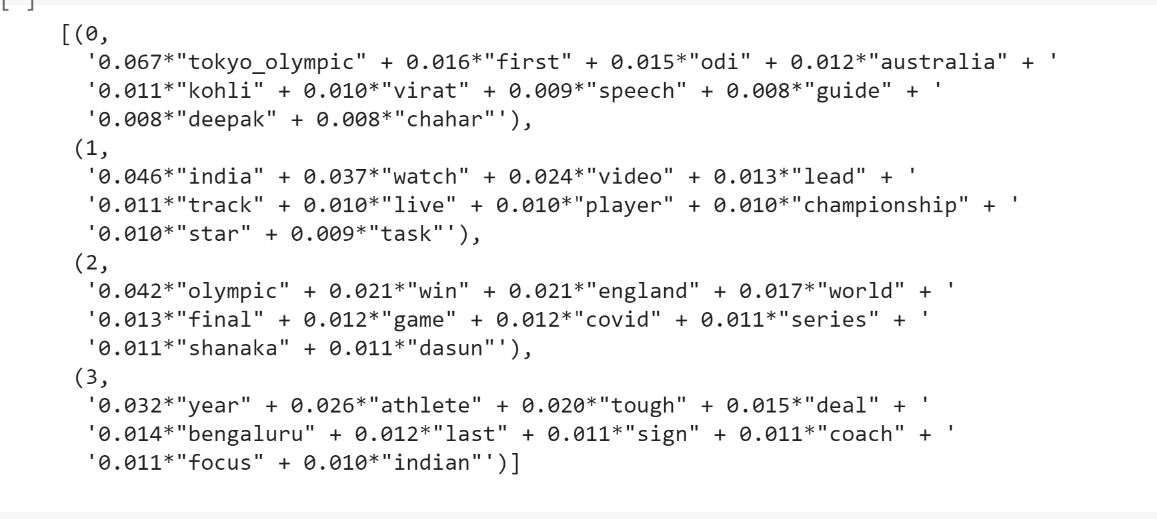
Build the bigram and trigram models

Slide 14
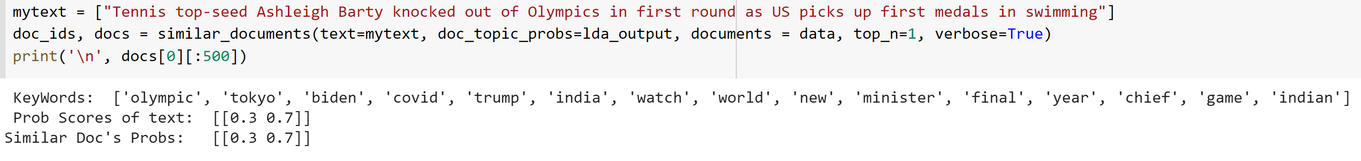
Predict Topics (1 - Politics, 2- Sports)
1st Element – Politics
2nd Element - Sports
70% Probability of the 2nd element represents Test Sentence belongs to Sports Category

Slide 15
END

